Slide 1
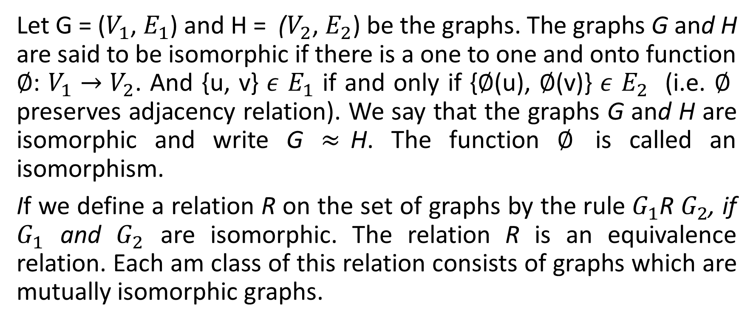
Isomorphism of Graphs
Let G = ($V_{1}$, $E_{1}$) and H = ($V_{2}$, $E_{2}$) be the graphs. The graphs G and H are said to be isomorphic if there is a one to one and onto function $∅$: $V_{1}→V_{2}$. And {u, v} $ε$ $E_{1}$ if and only if {$∅$(u), $∅$(v)} $ε$ $E_{2}$ (i.e. $∅$ preserves adjacency relation). We say that the graphs G and H are isomorphic and write G $≈$H. The function $∅$ is called an isomorphism.
If we define a relation R on the set of graphs by the rule $G_{1}$R $G_{2}$, if $G_{1}$ and $G_{2}$ are isomorphic. The relation R is an equivalence relation. Each am class of this relation consists of graphs which are mutually isomorphic graphs.

Slide 2
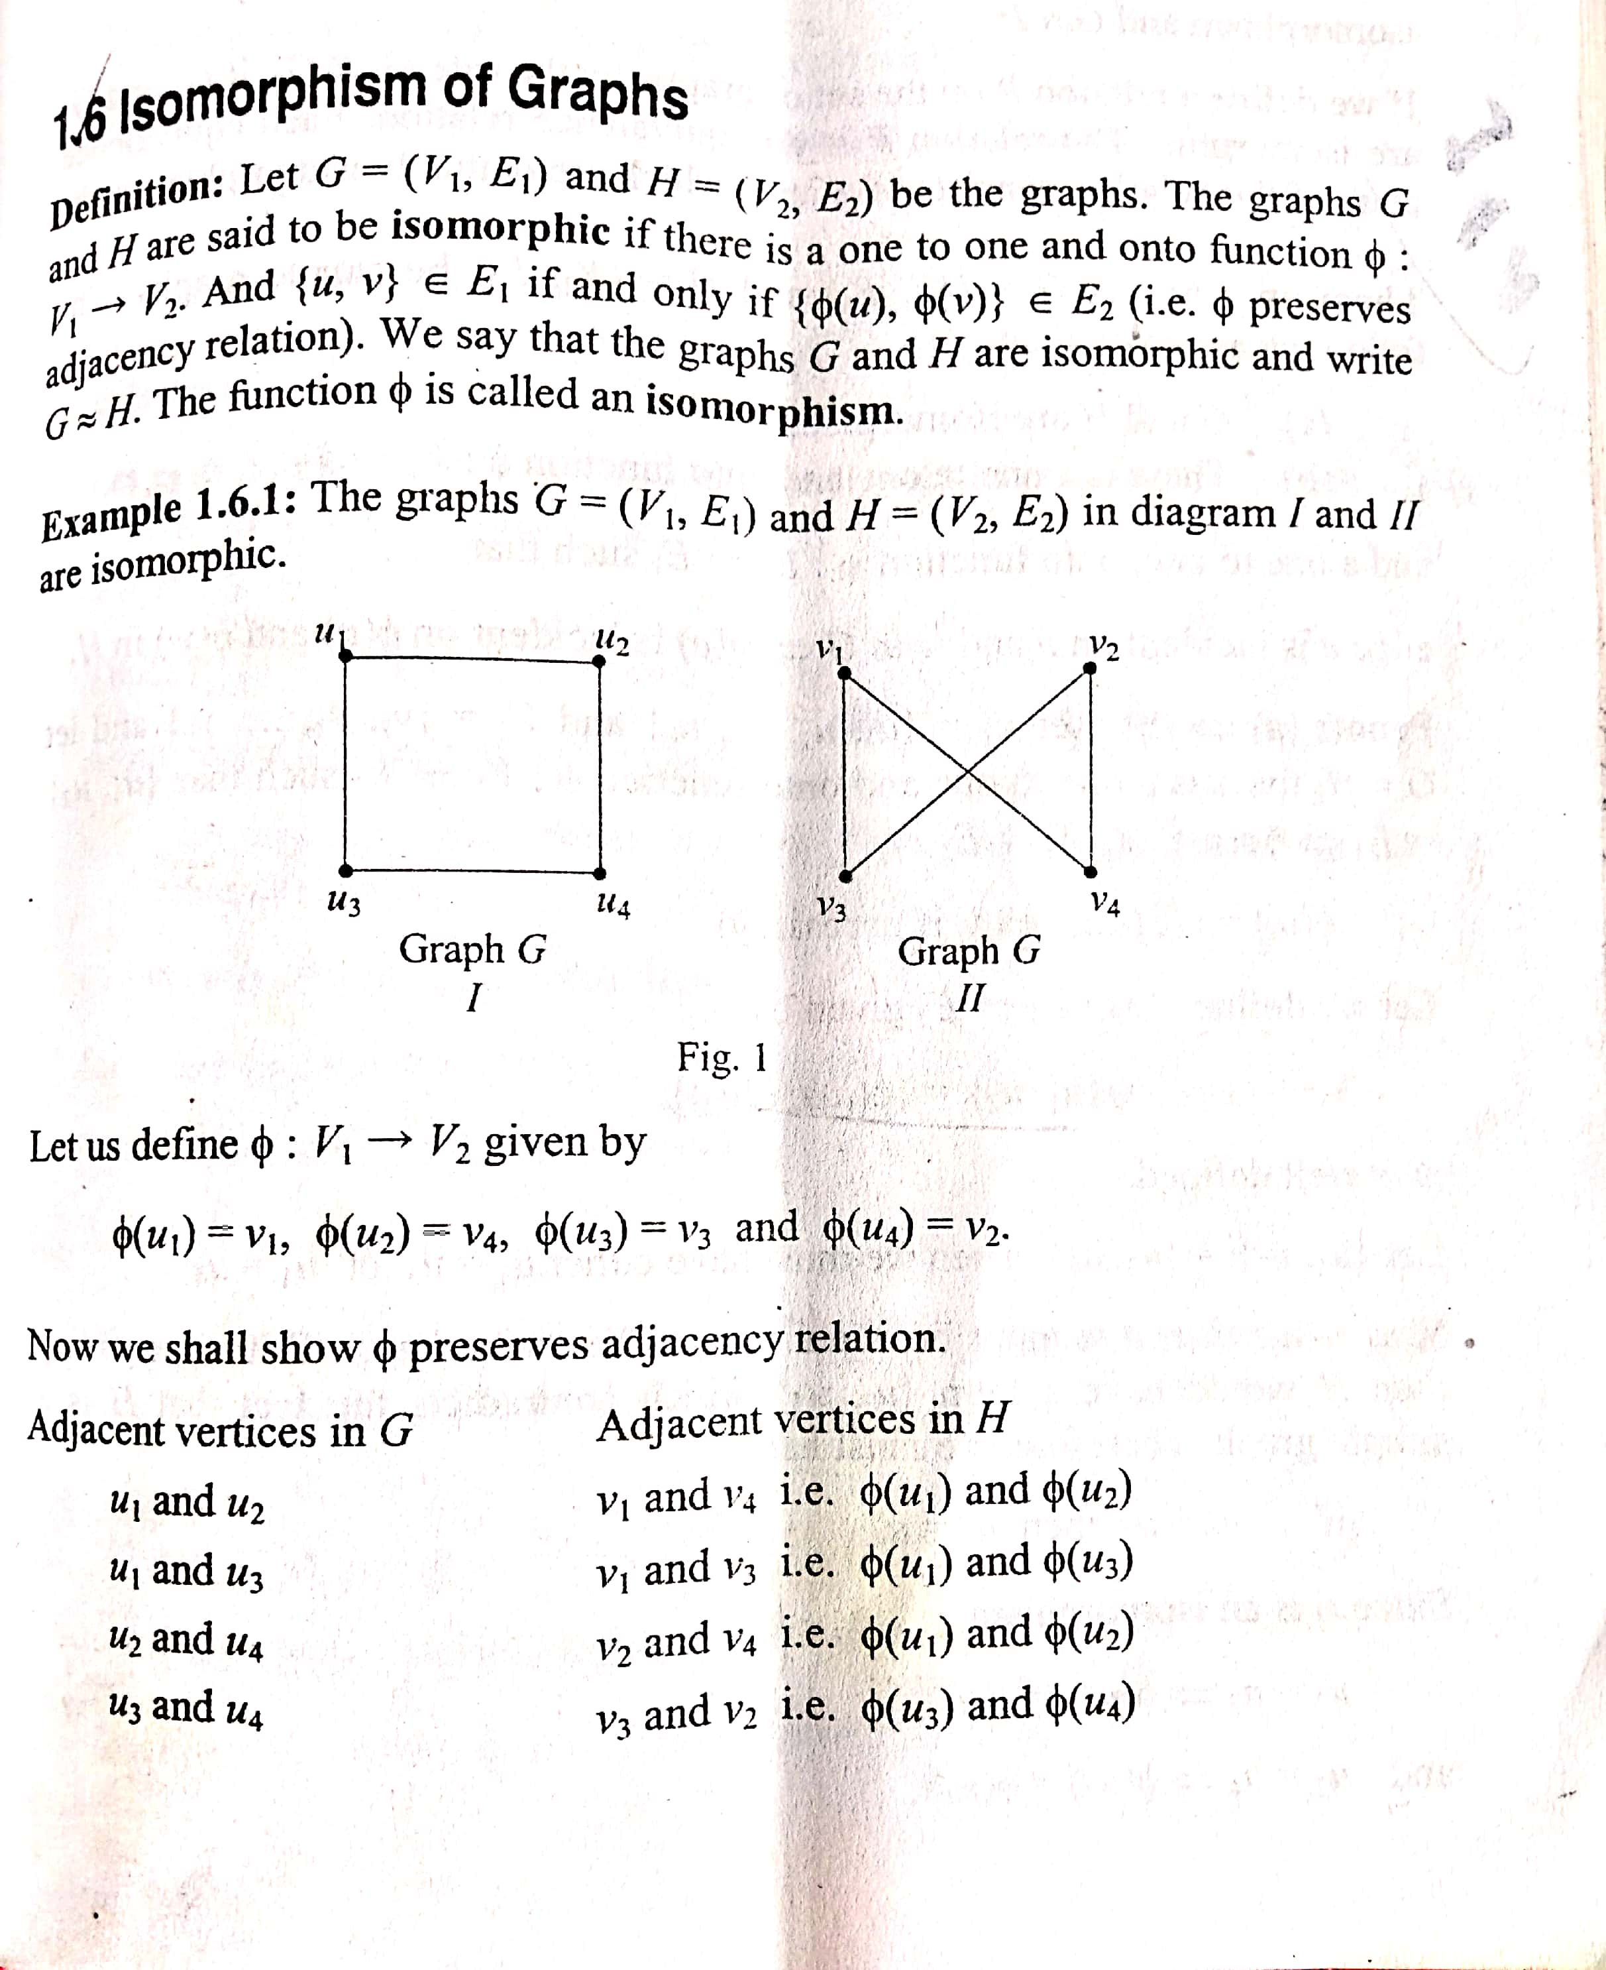

Slide 3
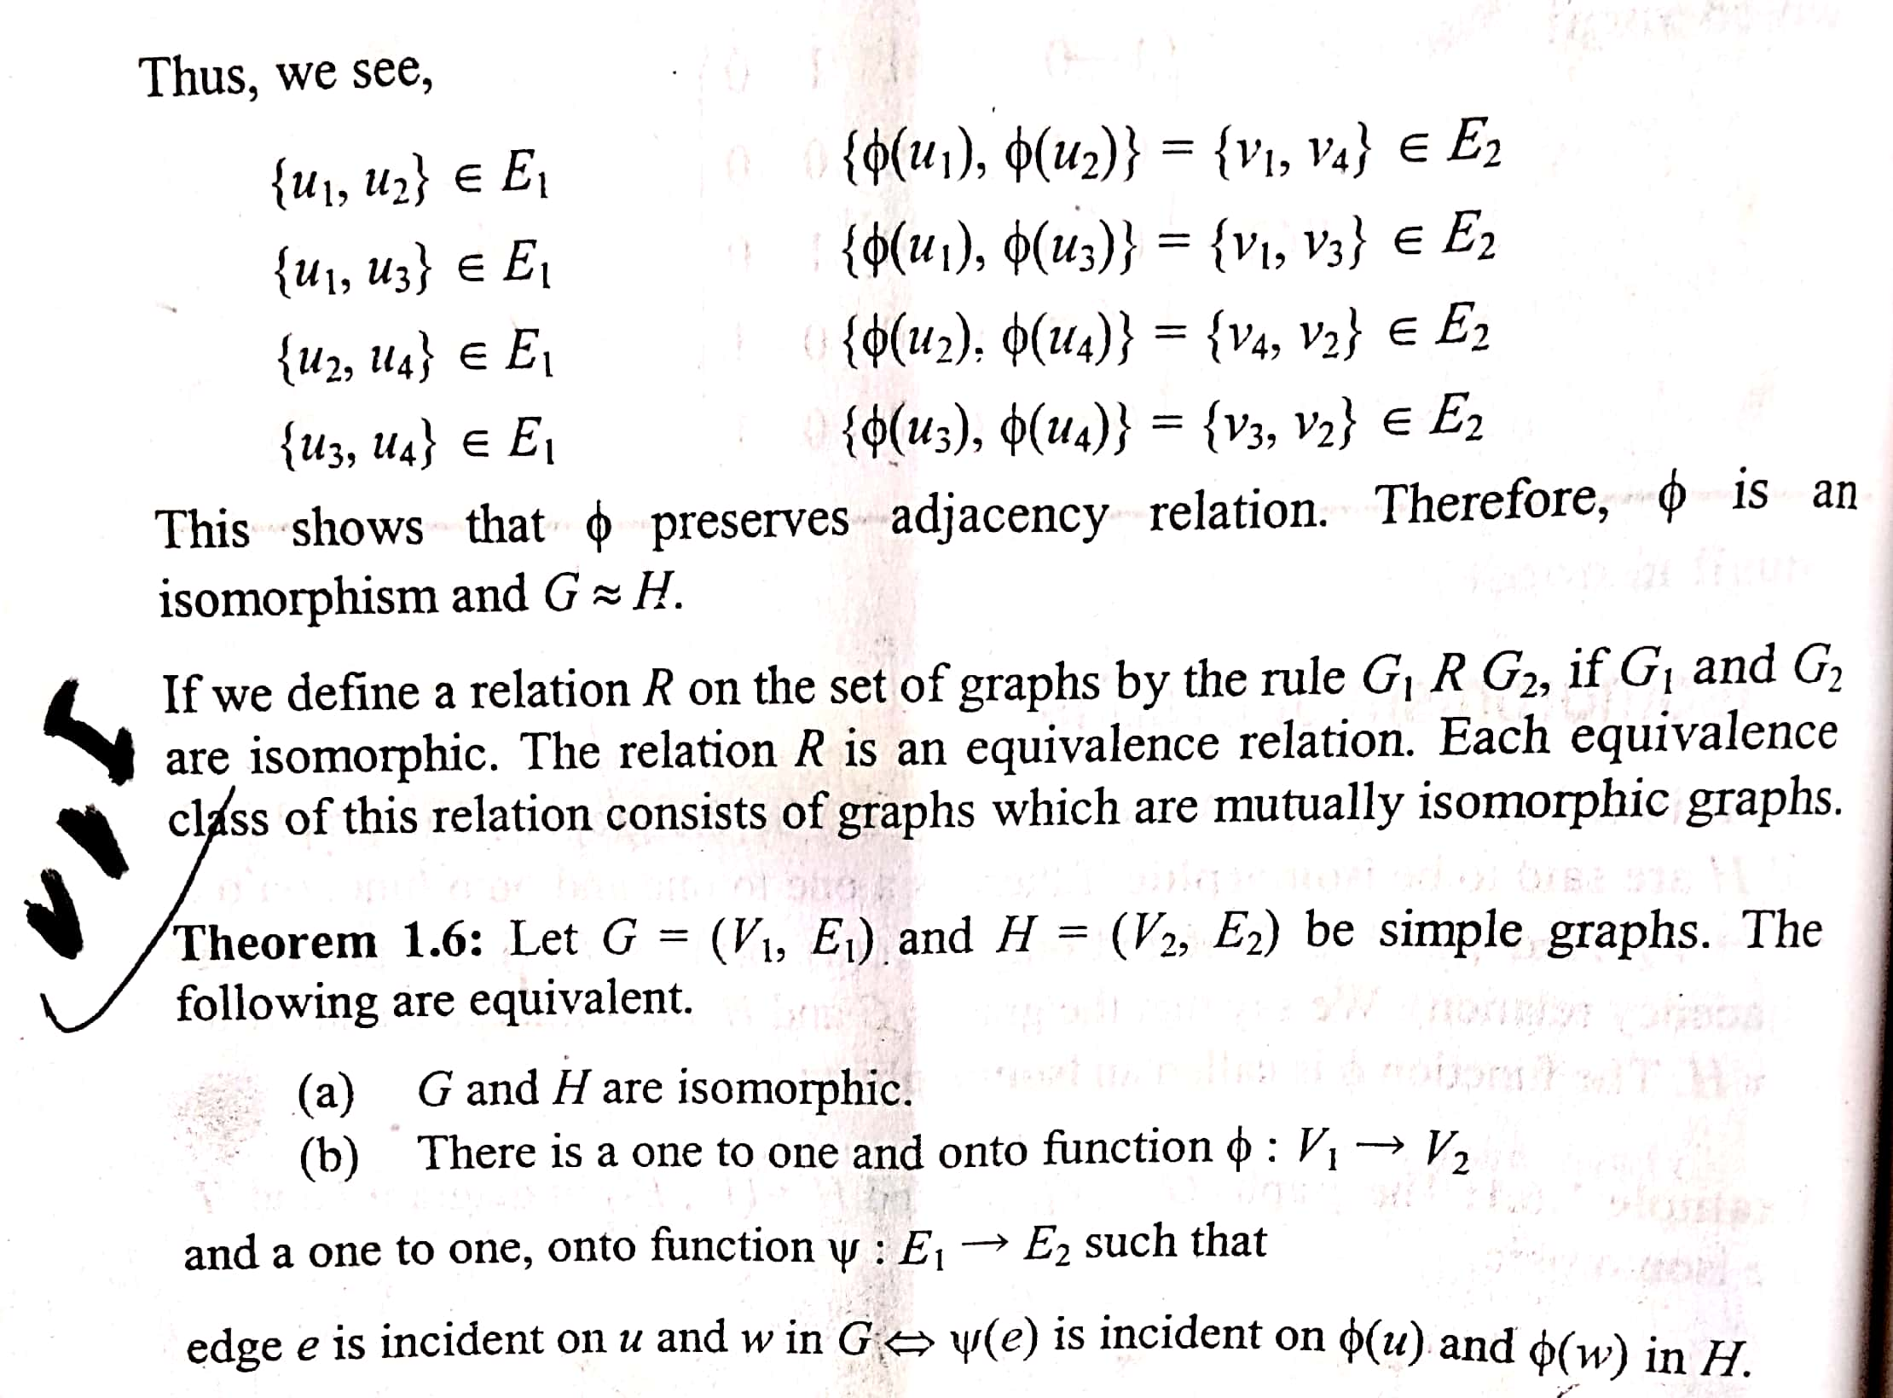

Slide 4
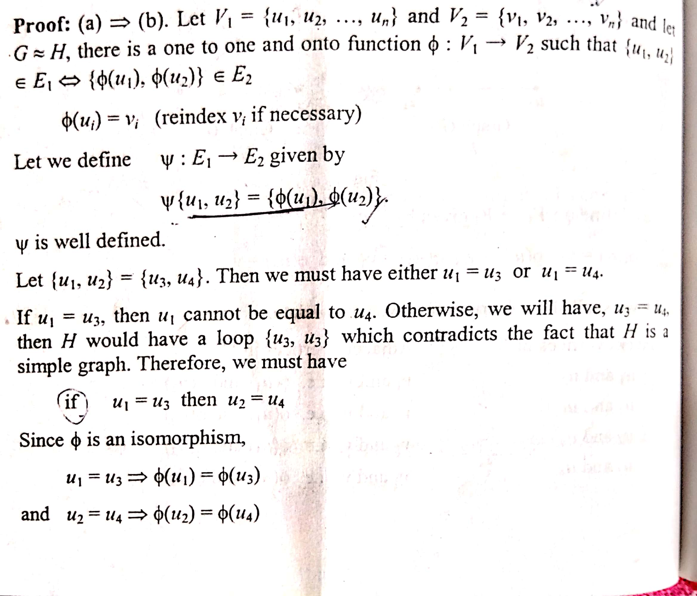

Slide 5
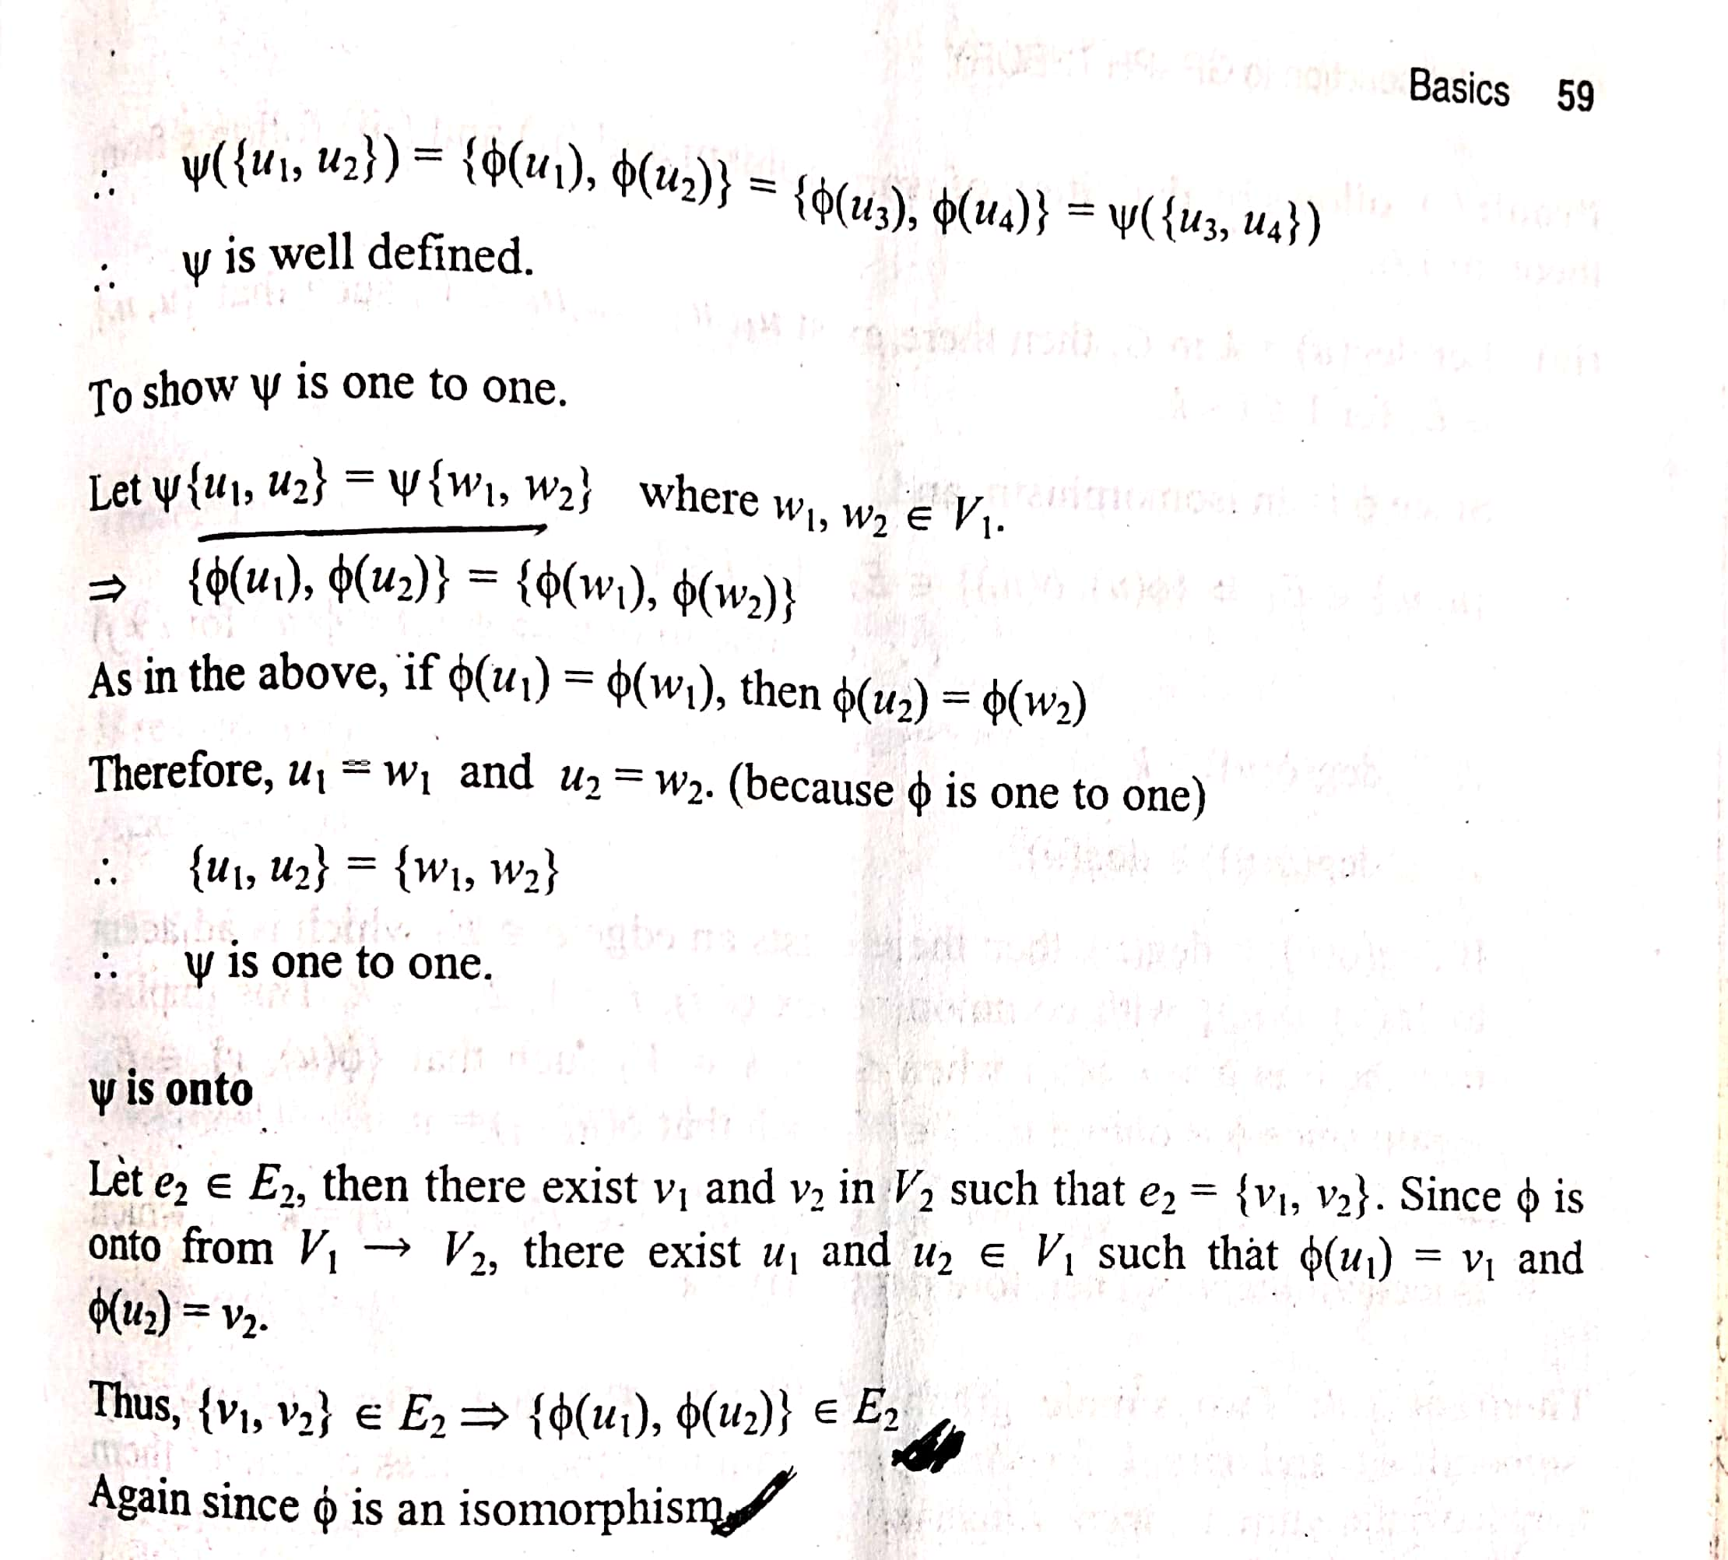

Slide 6
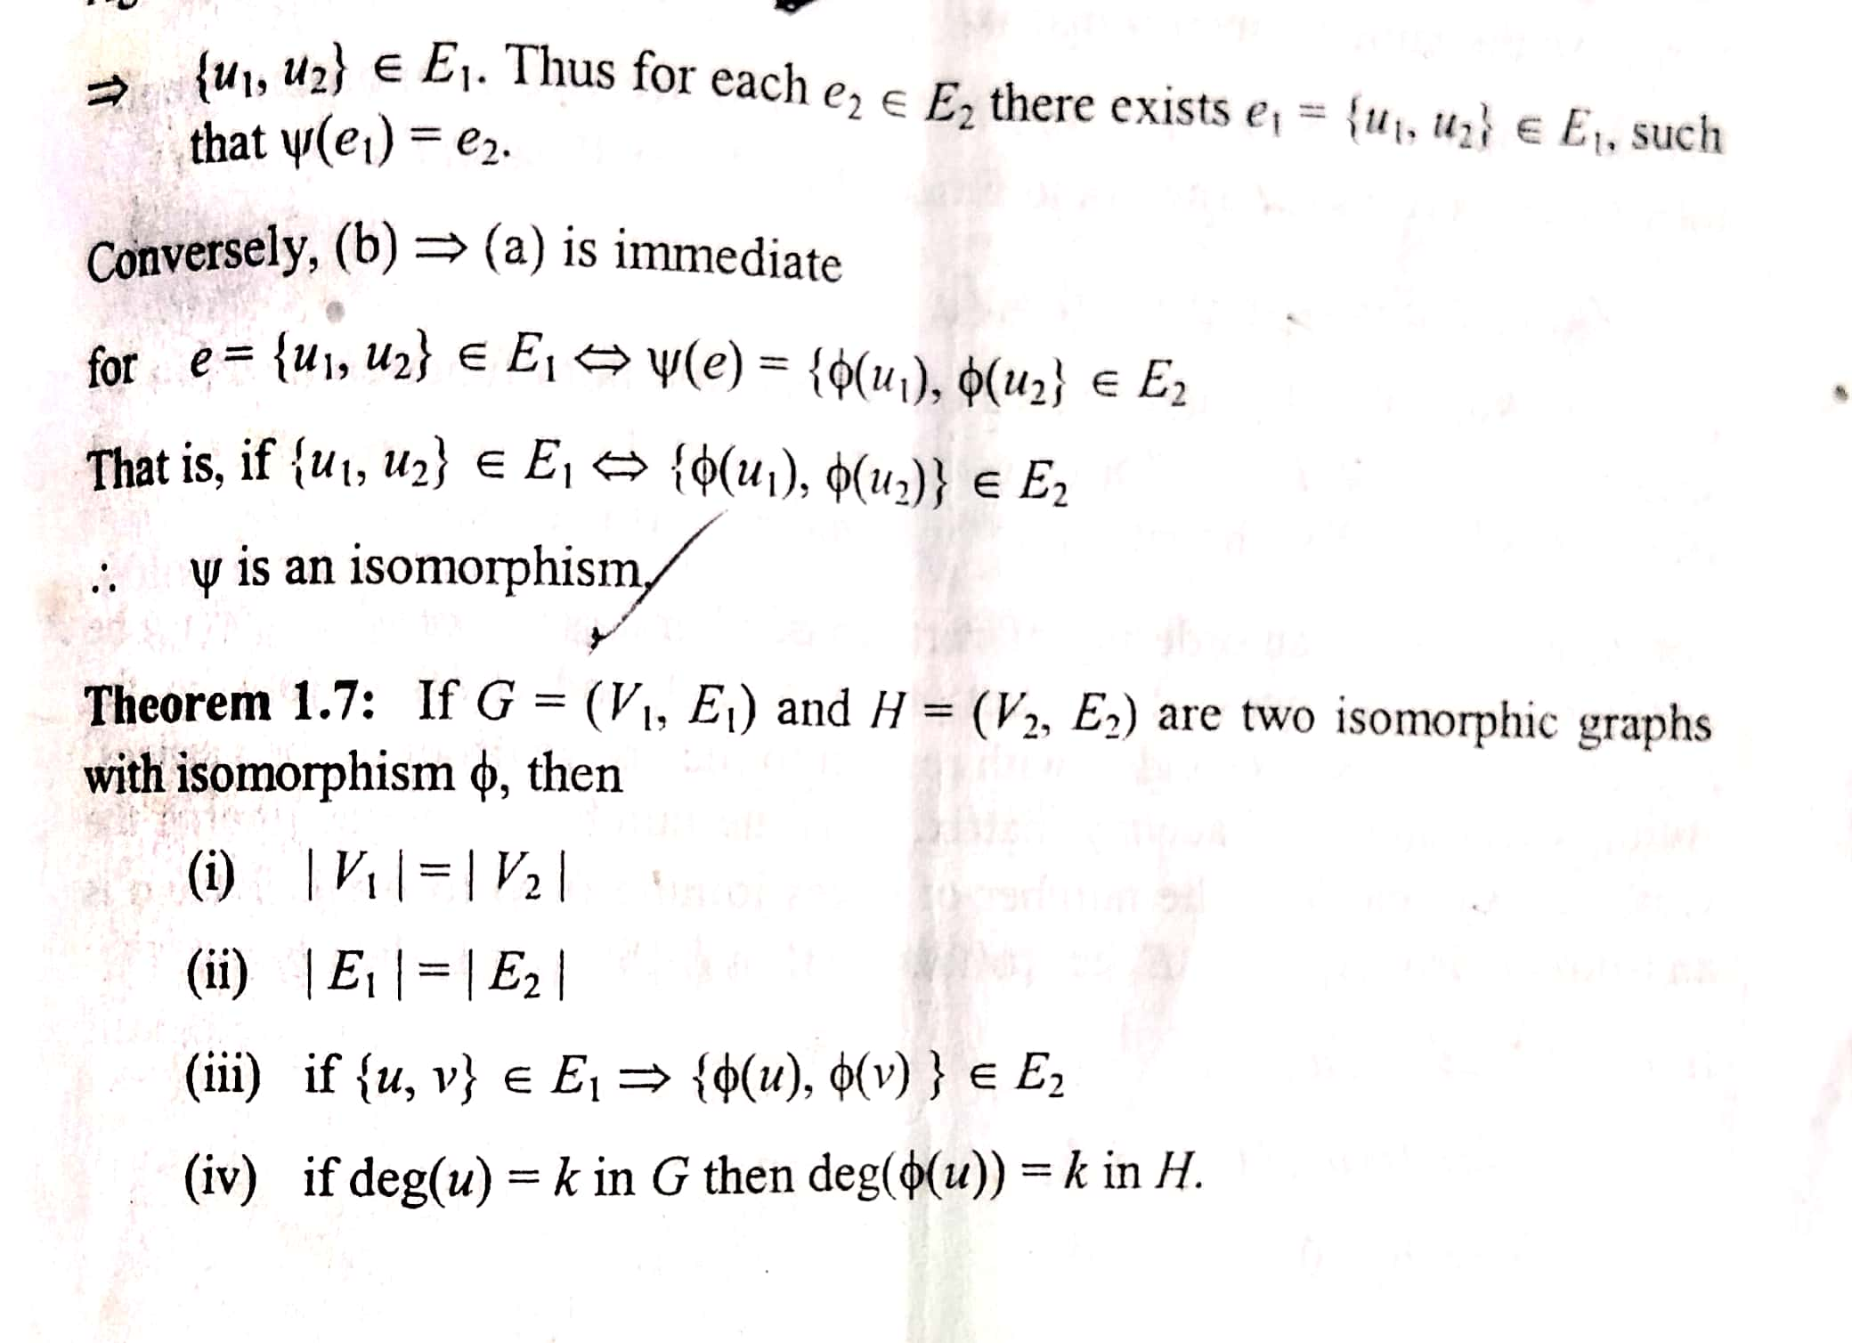

Slide 7
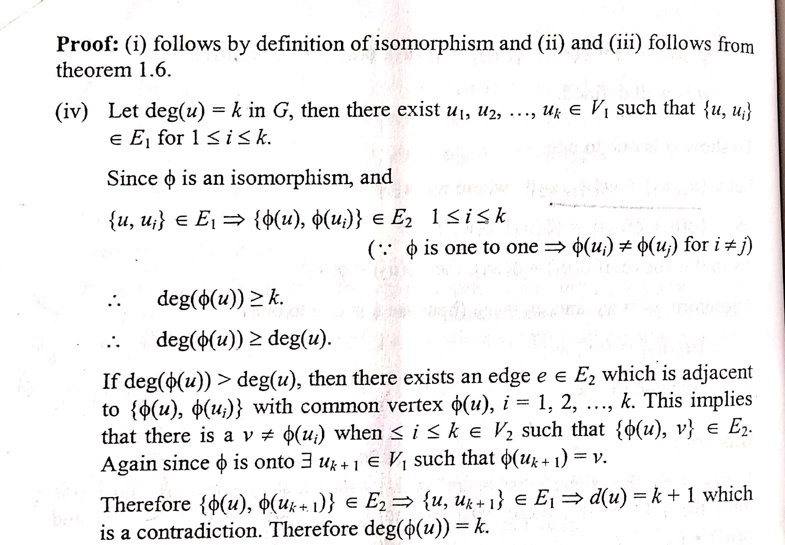

Slide 8
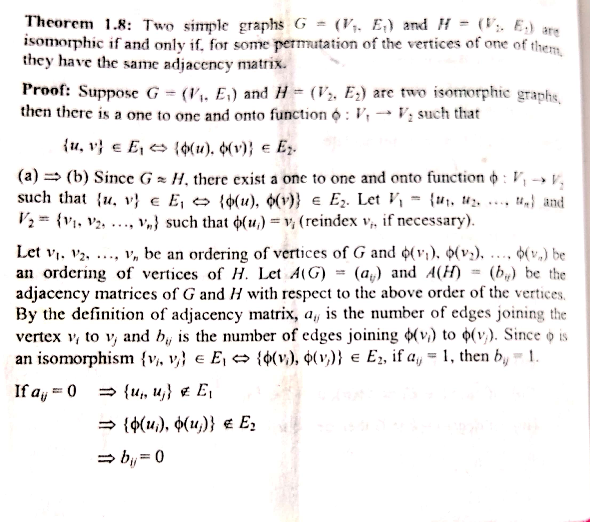

Slide 9
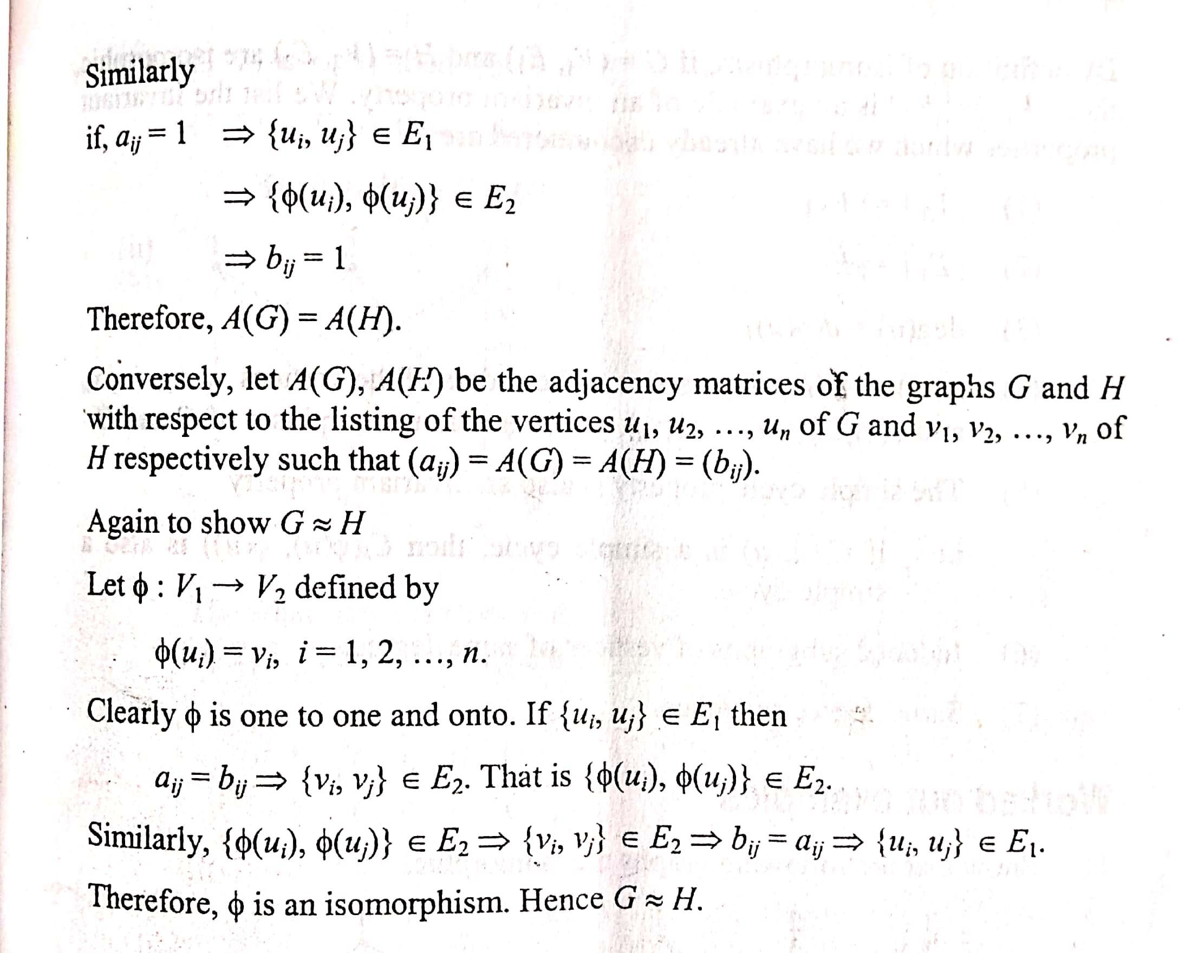

Slide 10
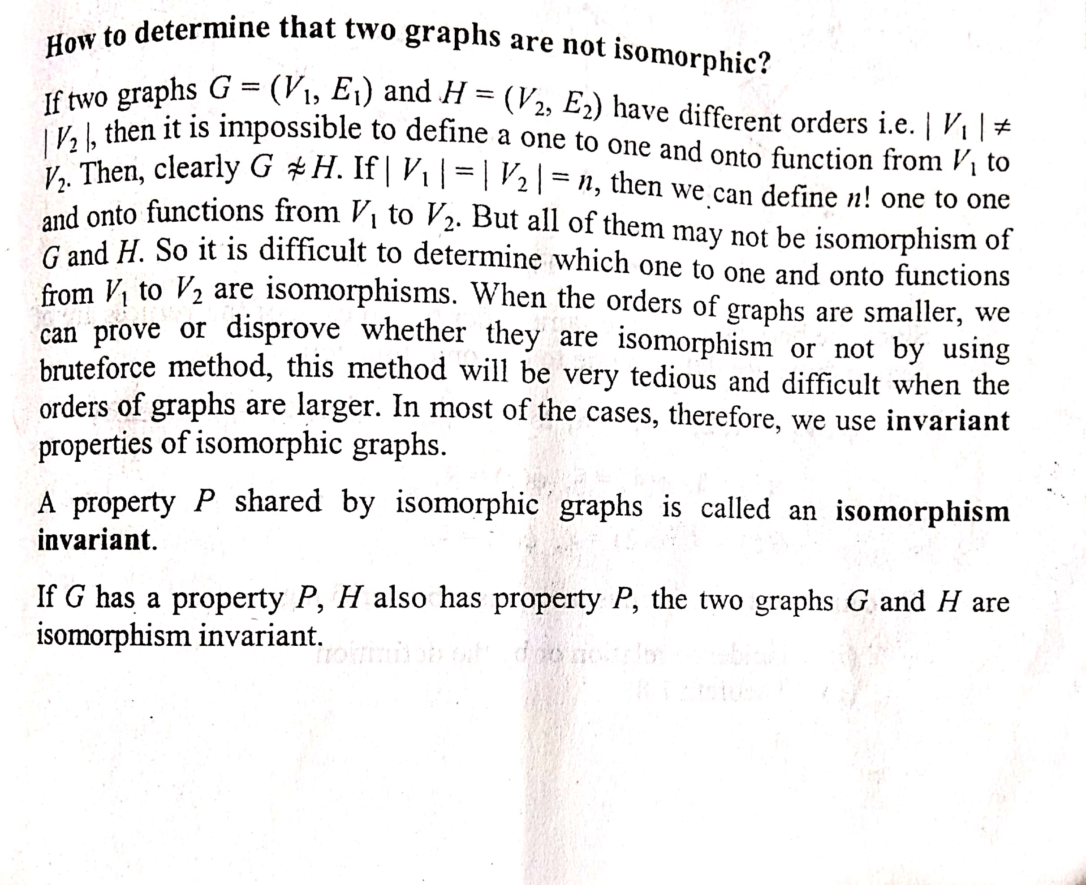

Slide 11
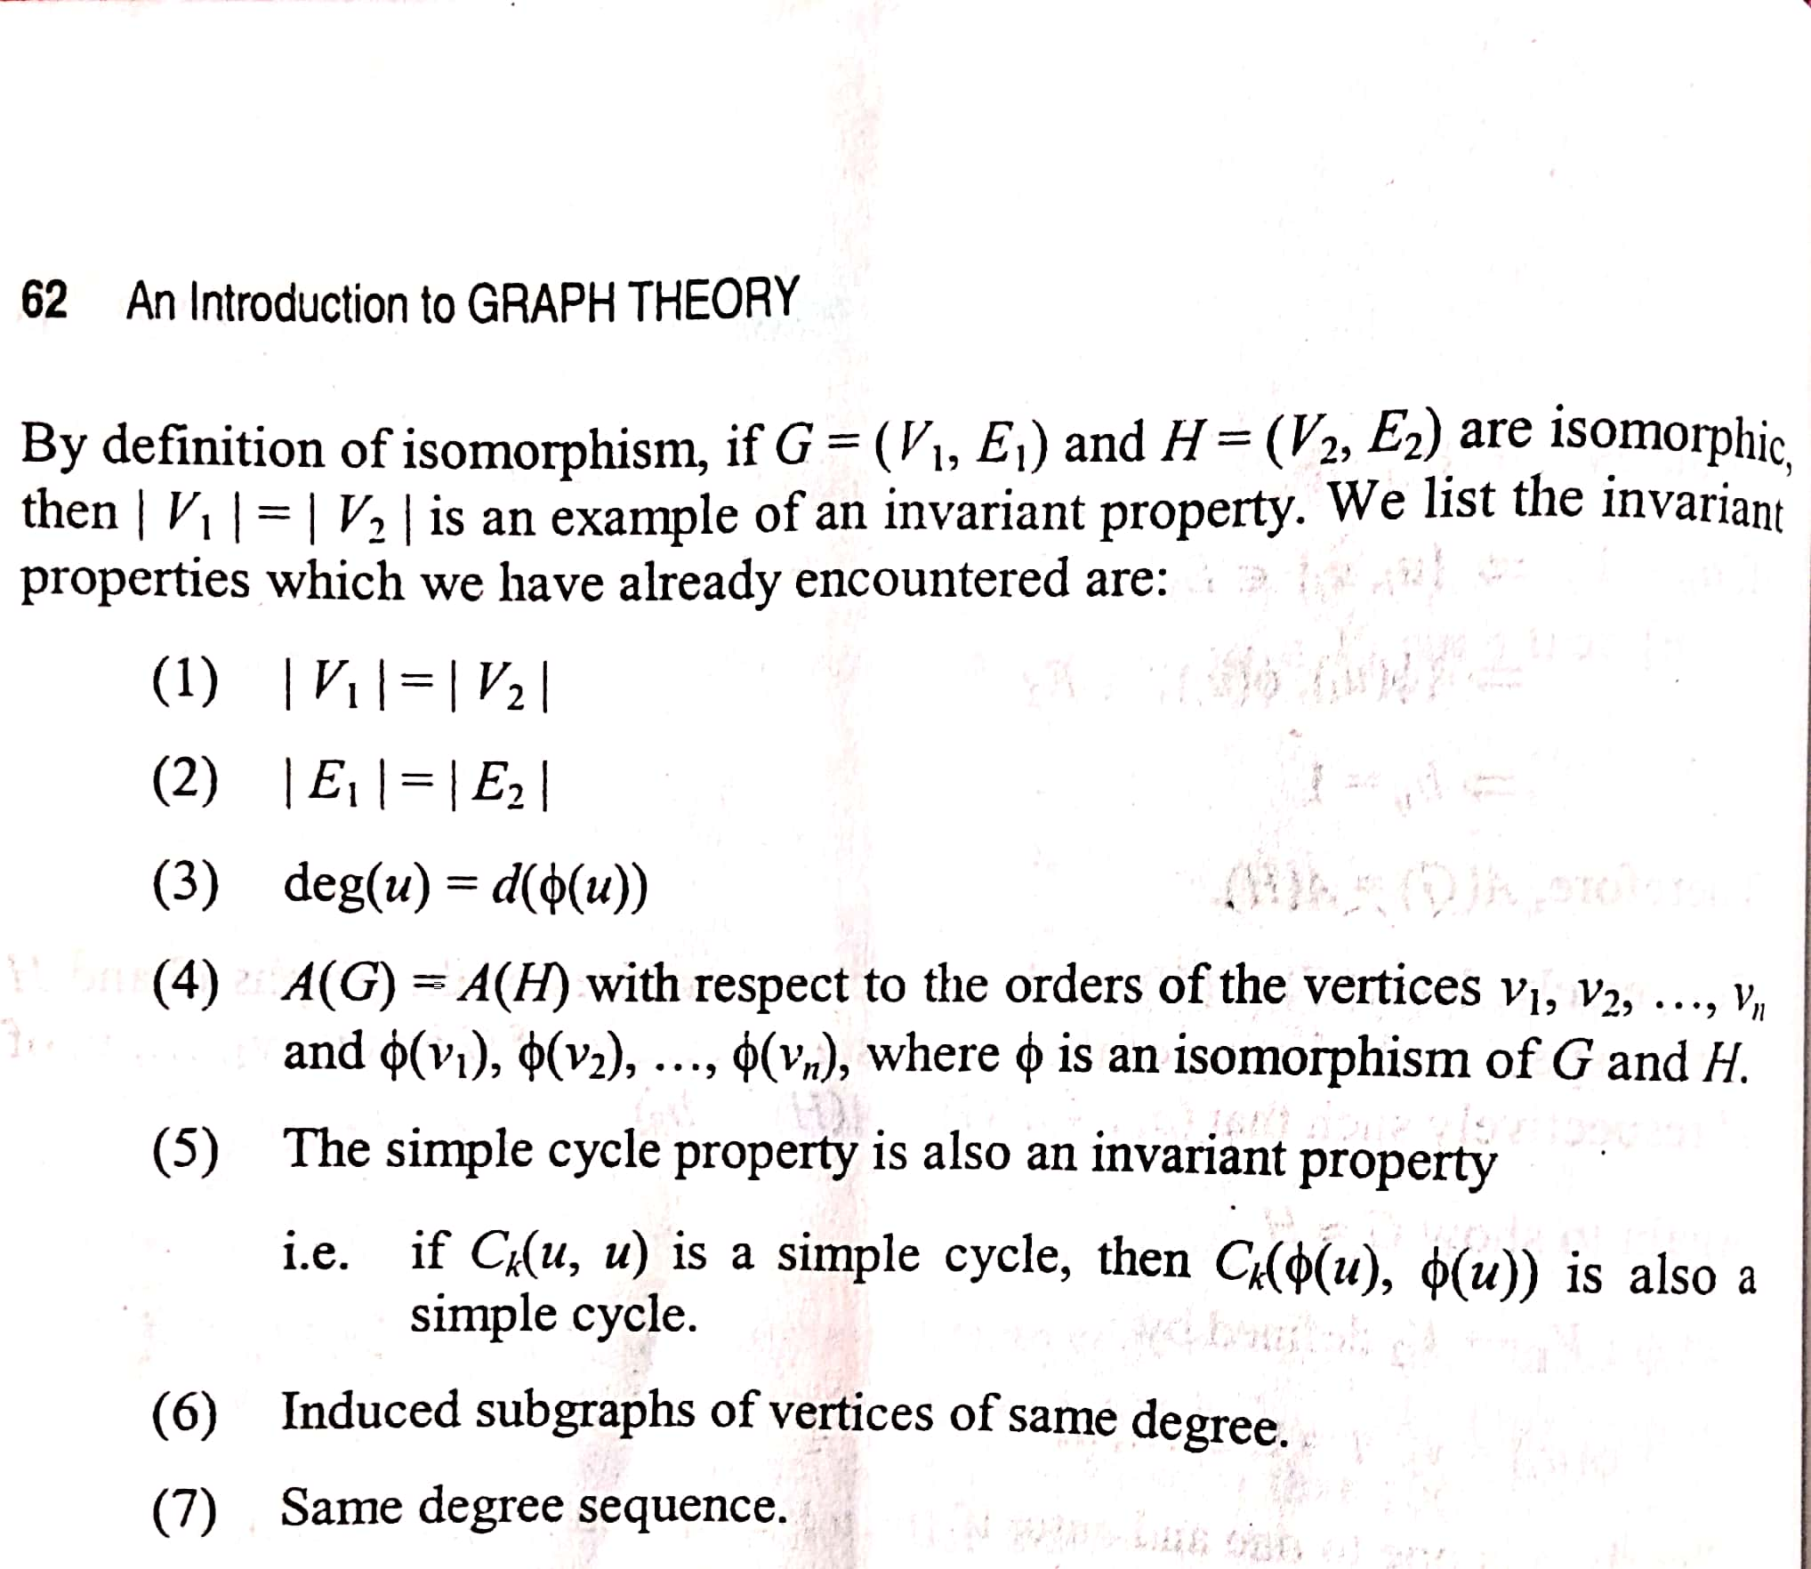

Slide 12
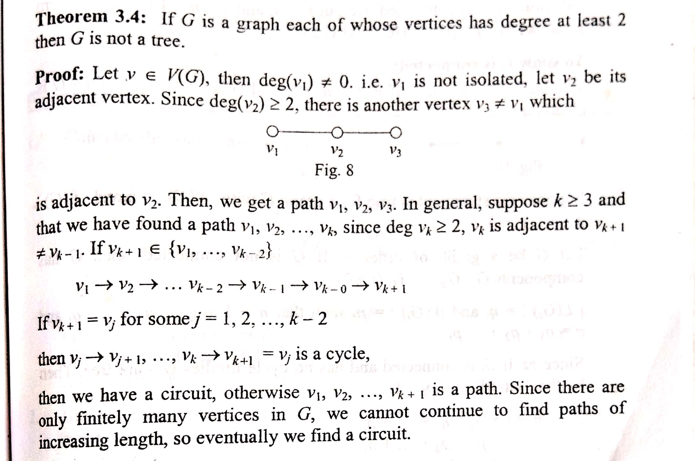

Slide 13


